Slide 1
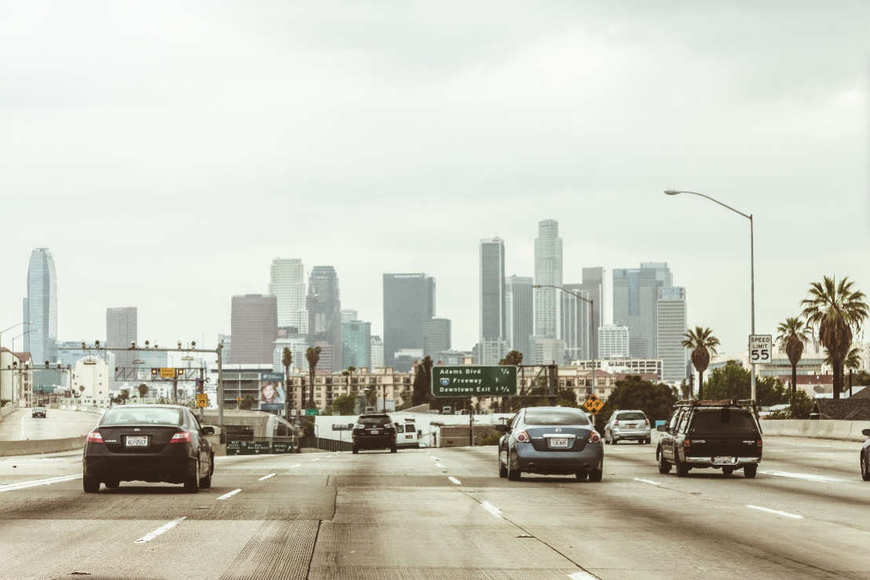
IA DATA SOLUTIONS
Vehicle annotation portfolio
Road scene
Polygon annotation
Original image comparison
A visual sample of six selected vehicles, including an occluded van and vehicles with visible tyres.
Label Studio
CLIENT REVIEW DRAFT
01
Notes:
Source: user-provided Screenshot 2026-10-18 033112.png. Original view means annotation hidden in the supplied screenshot. This is not an original-resolution source file. Portfolio scope covers six selected vehicles. This version remains a review draft.

Slide 2
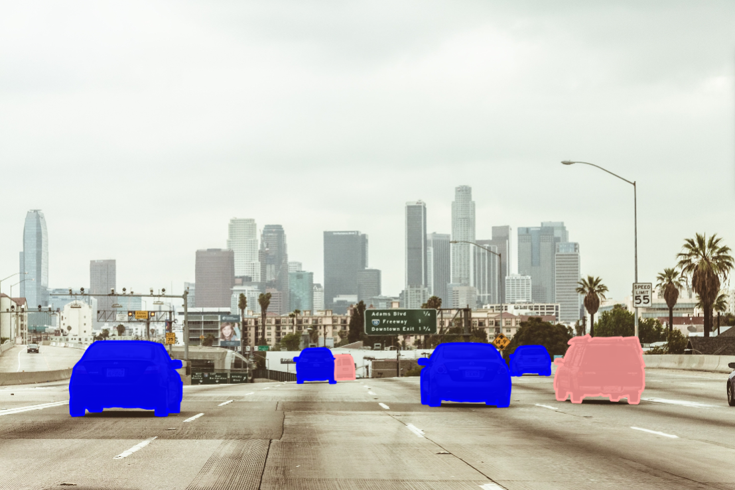
IA DATA SOLUTIONS
Full scene with annotations
Six selected vehicles
Individual polygons distinguish adjacent vehicles and follow visible boundaries.
Scope: the distant left car and the partial vehicle at the far-right edge remain unlabelled.
CLIENT REVIEW DRAFT
02
Notes:
Source: user-provided Screenshot 2026-10-18 033054.png. Preserve all supplied annotations. Blue and pink fills reproduce the current project display. No scores, accuracy percentages or complete-scene coverage claims are made.

Slide 3
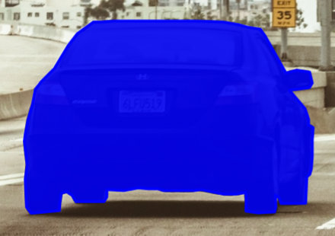
IA DATA SOLUTIONS
Annotation skills demonstrated
01
Contour tracing
BOUNDARY REVIEW EXAMPLE
Points follow changes in the visible vehicle silhouette.
02
Occlusion handling
Separate regions follow overlaps between vehicles.
03
Tyres and shadows
Visible tyres stay inside. Road and cast shadows stay outside.
04
Visual quality review
Original and annotated views support boundary checks.
Actual annotation screenshot
CLIENT REVIEW DRAFT
03
Notes:
Skill descriptions relate only to the supplied vehicle polygon samples. No claim is made about production accuracy, throughput, certifications or independent quality validation. Image source: Screenshot 2026-10-18 031733.png. Reused as a detail example requested for the portfolio.

Slide 4
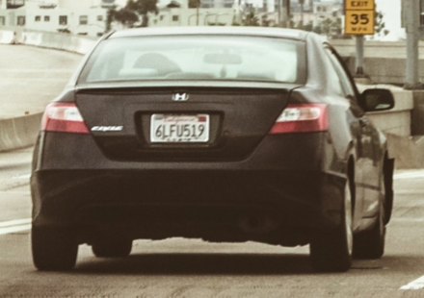
IA DATA SOLUTIONS
Honda sedan
ORIGINAL VIEW
ANNOTATED VIEW
Mirror and tyre boundaries
Visible tyre sections stay inside the outline. The dark road shadow remains outside.
CLIENT REVIEW DRAFT
04
Notes:
Sources: user-provided Screenshot 2026-10-18 031706.png and Screenshot 2026-10-18 031733.png. Cropped at comparable scale without modifying annotations. Original means annotation hidden. Source screenshots limit precise pixel-edge assessment.

Slide 5
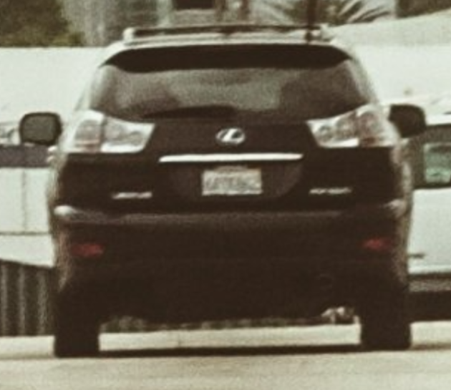
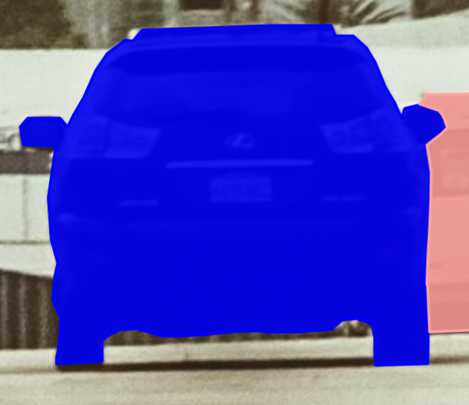
IA DATA SOLUTIONS
Lexus SUV
ORIGINAL VIEW
ANNOTATED VIEW
Separation between vehicles
The foreground SUV boundary stays separate from the white van behind it.
CLIENT REVIEW DRAFT
05
Notes:
Sources: user-provided Screenshot 2026-10-18 032948.png and Screenshot 2026-10-18 033007.png. Cropped at comparable scale without modifying annotations. Original means annotation hidden. Current outer polygon fills the roof-rack openings. Source screenshots limit precise pixel-edge assessment.

Slide 6
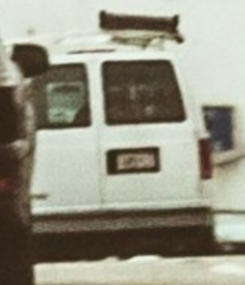
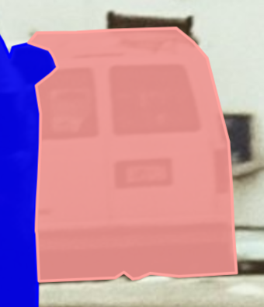
IA DATA SOLUTIONS
Partially occluded white van
ORIGINAL VIEW
ANNOTATED VIEW
Visible-part annotation
The van polygon follows the SUV overlap. Hidden body sections are not reconstructed.
CLIENT REVIEW DRAFT
06
Notes:
Sources: user-provided Screenshot 2026-10-18 032948.png and Screenshot 2026-10-18 033007.png. Cropped at comparable scale without modifying annotations. Original means annotation hidden. Source screenshots limit precise pixel-edge assessment.

Slide 7
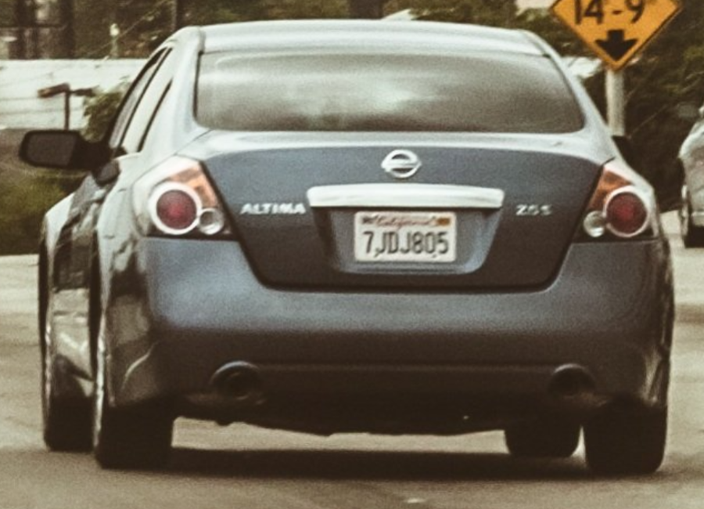
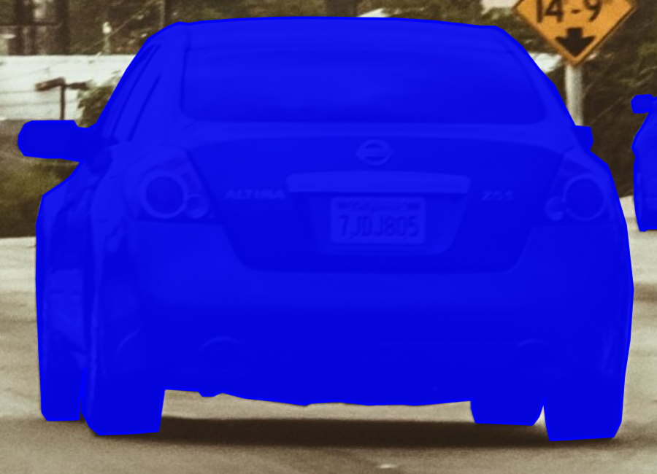
IA DATA SOLUTIONS
Nissan sedan
ORIGINAL VIEW
ANNOTATED VIEW
Body and underside contours
The outline follows the mirror and visible wheels, preserving the road gap beneath the body.
CLIENT REVIEW DRAFT
07
Notes:
Sources: user-provided Screenshot 2026-10-18 025849.png and Screenshot 2026-10-18 025831.png. Cropped at comparable scale without modifying annotations. Original means annotation hidden. Source screenshots limit precise pixel-edge assessment.

Slide 8
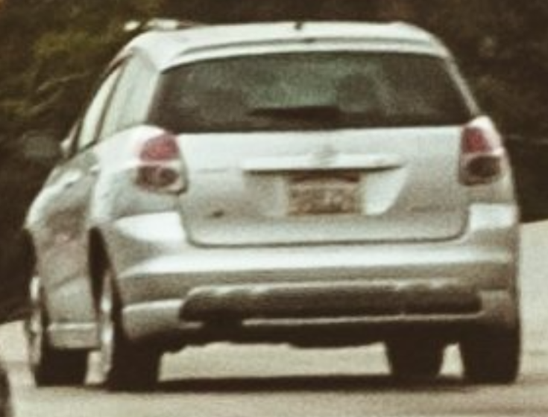
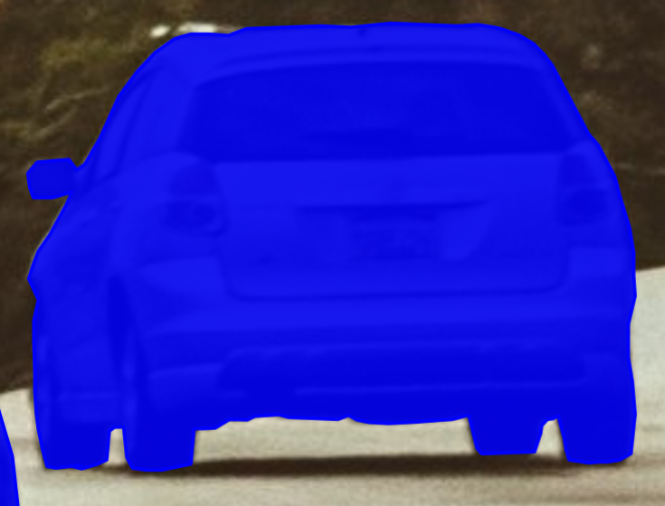
IA DATA SOLUTIONS
Silver compact car
ORIGINAL VIEW
ANNOTATED VIEW
Curved silhouette
The polygon follows the roof, body sides and separate visible tyre sections.
CLIENT REVIEW DRAFT
08
Notes:
Sources: user-provided Screenshot 2026-10-18 031310.png and Screenshot 2026-10-18 031501.png. Cropped at comparable scale without modifying annotations. Original means annotation hidden. Source screenshots limit precise pixel-edge assessment.

Slide 9
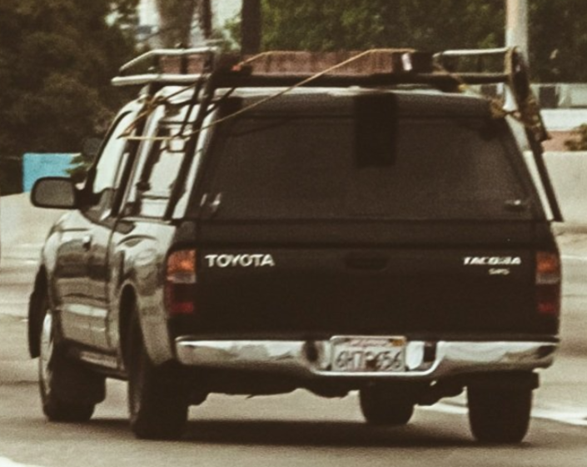
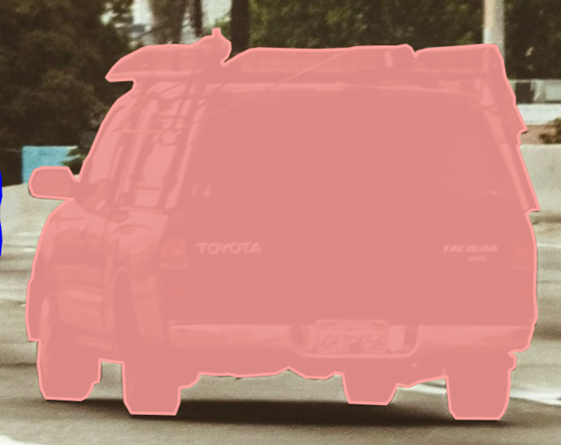
IA DATA SOLUTIONS
Toyota with roof luggage rack
ORIGINAL VIEW
ANNOTATED VIEW
Attached equipment
The current outer outline includes the visible luggage rack, mirror and tyres.
CLIENT REVIEW DRAFT
09
Notes:
Sources: user-provided Screenshot 2026-10-18 031155.png and Screenshot 2026-10-18 031140.png. Cropped at comparable scale without modifying annotations. Original means annotation hidden. The current project class is VAN. Toyota body classification, a protruding rack boundary point and filled rack openings remain unresolved. Source screenshots limit precise pixel-edge assessment.

Slide 10
IA DATA SOLUTIONS
Sample scope and project discussion
Current sample
Before production delivery
Six selected vehicle polygons
Original and annotated comparisons
Review in Label Studio
Agree vehicle class definitions and rack-gap rules.
Confirm the Toyota class and rack boundary.
Check the source image and annotation export.
IA Data Solutions (SMC-Private) Limited
info@iadatasolutions.com
iadatasolutions.com
CLIENT REVIEW DRAFT
10
Notes:
This deck remains a review draft. The source screenshots show filled background openings inside outer rack outlines and an unresolved Toyota class. Production delivery requires agreed definitions and checked export files. Contact information comes from the user-provided company context. No annotation export has been supplied or verified.

